Slide 1
Lecture One
Microprocessor Basics

Slide 2
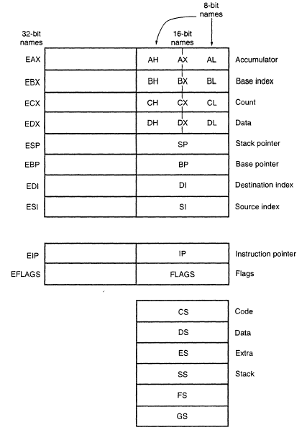
Programming Model of Intel x86

Slide 3
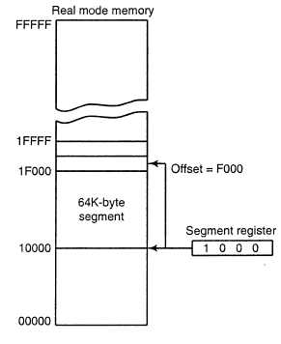
Segment and Offset Address
Segment Address defines the beginning of any memory segment.
Offset Address selects any location within this memory segment.
address=segment×10+offset

Slide 4
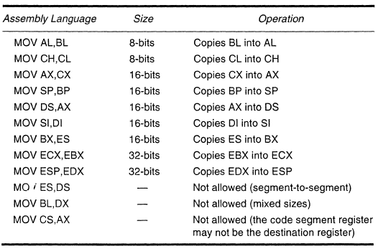
Microprocessor Instruction- MOV

Slide 5
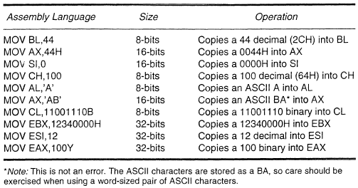
Microprocessor Instruction- MOV

Slide 6
Microprocessor Instruction- PUSH and POP
The PUSH instruction takes data from a 16-bit register, segment register or 16-bit memory location and places it into stack.
The POP instruction removes data from stack and places it into the target 16-bit register, segment register or 16-bit memory location.

Slide 7
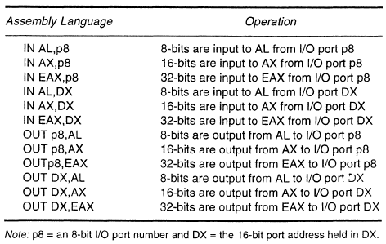
Microprocessor Instruction- IN and OUT

Slide 8
Arithmetic Instructions
ADD AL,BL | AL=AL+BL
ADC AL,AH | AL=AL+AH+Carry
SUB CL,BL | CL=CL-BL
SBB AH,AL | AH=AH-AL-Carry
INC BL | BL=BL+1
DEC BH | BH=BH-1
CMP CL,BL | CL-BL
MUL CL | AX=AL×CL
MUL CX | DX-AX=AX×CX
DIV CL | AX/CL; AL contains quotient and AH contains remainder

Slide 9
Logic Instructions
AND, OR, XOR and NOT are the basic logic operations.
AND AL, BL means AL=AL and BL, so do the OR and XOR.
NOT means one’s complement.
NEG means two’s complement.
TEST instruction performs the AND operation but without
changing the content of the destination operand.

Slide 10
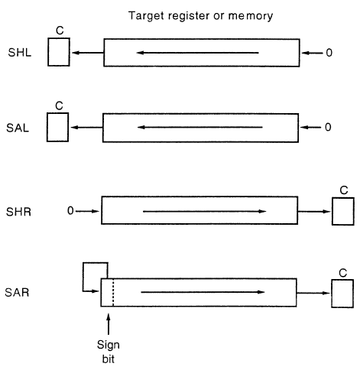
Shift Instruction

Slide 11
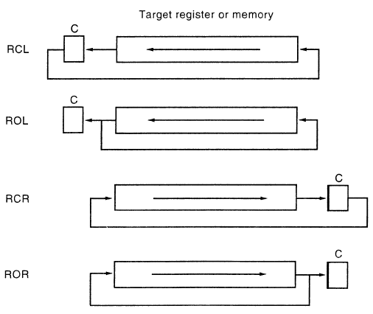
Rotate Instruction

Slide 12
JMP, CALL and RET Instructions
JMP Instruction transfers the program control to a memory
location. If the JMP is within the current memory segment,
then the JMP is near; else the JMP is far.
CALL is similar to JMP, except that it has a return address.
RET instruction is usually used at the ending of a procedure
so that the flow of program can be returned to the address
stored in stack.

Slide 13
Hierarchy of Memory
Storage
Device
Memory
Cache
Registers
Microprocessor
# Data Processing Speed Increases
# Amount of Data Decreases
# Cost of Production Increases

